Slide 1

Clean and Prep: Power Query
George Mount
Steve Kraynak

Slide 2


About me
Director - SumProduct US, LLC (find us at SumProduct.com)
Microsoft MVP (M365, Excel)
12 years as Product Manager for Excel at Microsoft:
New functions: TEXTJOIN, IFS, MAXIFS/MINIFS, others
Excel for Mac and iPad
Ease of use: customer-requested improvements
Accessibility and STEM Education
Enterprise Spreadsheet Management
Technical Lead at a software company acquired by Microsoft
10+ years in Vaccine Manufacturing
Father of 4 including triplets!

Slide 3

About me
Founder, Stringfest Analytics
Microsoft MVP (M365, Excel)
LinkedIn Learning Instructor
Author (seven books and counting!)
Cleveland local

Slide 4
Learning Objectives
Understand the basics of Power Query and the editor
Naming queries and steps in a query
Data profiler near column headings
Recognizing data types
Learn common data cleanup and manipulation tasks
Merge queries so you no longer need lookup formulas
Import data from text files in a folder
Control loading of query data
Know how to organize, rename, and copy to other workbooks

Slide 5

Power Query overview
Four phases of getting data:
Connect Make connections to data in the cloud, on a service, or locally
Transform Shape data to meet your needs, while the original source remains unchanged
Combine Integrate data from multiple sources to get a unique view into the data
Load Complete your query and load it into a worksheet or Data Model and periodically refresh it.
Source: https://support.microsoft.com/en-us/office/about-power-query-in-excel-7104fbee-9e62-4cb9-a02e-5bfb1a6c536a

Slide 6
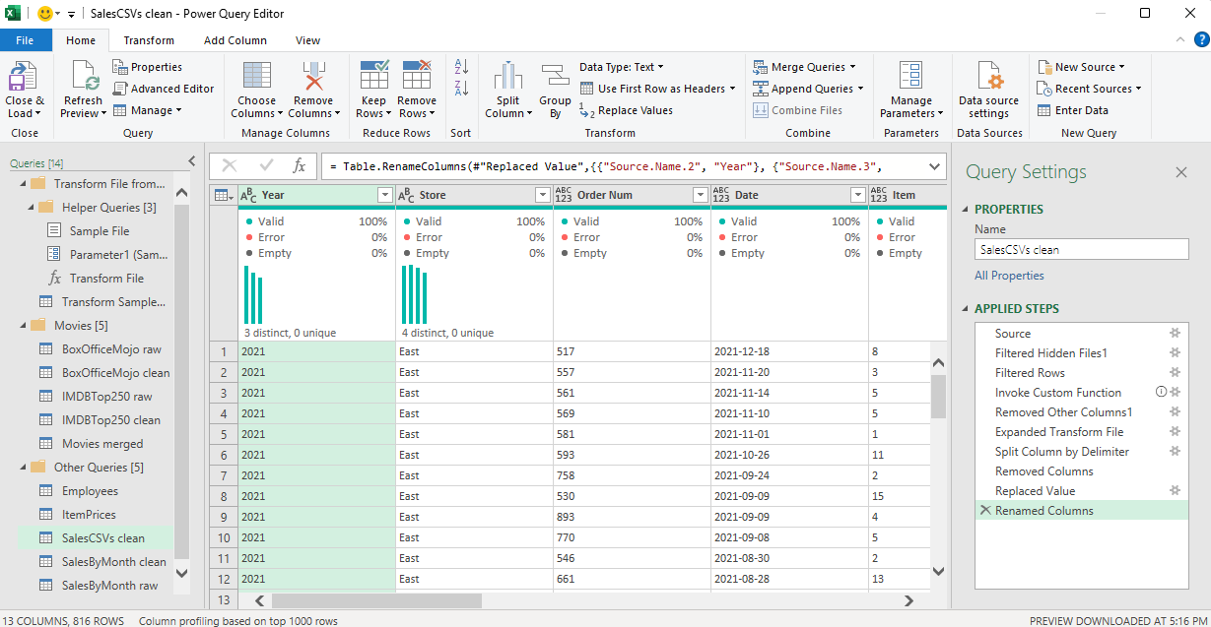
Power Query editor
Shortcuts:
Alt+F12 to open the editor
Zoom in: Ctrl+Shift+ ‘+’
Zoom out: Ctrl+Shift+ ‘-’
Reset zoom: Ctrl+0

Slide 7
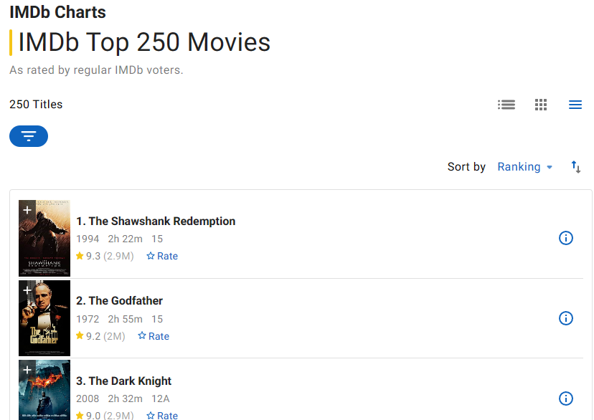
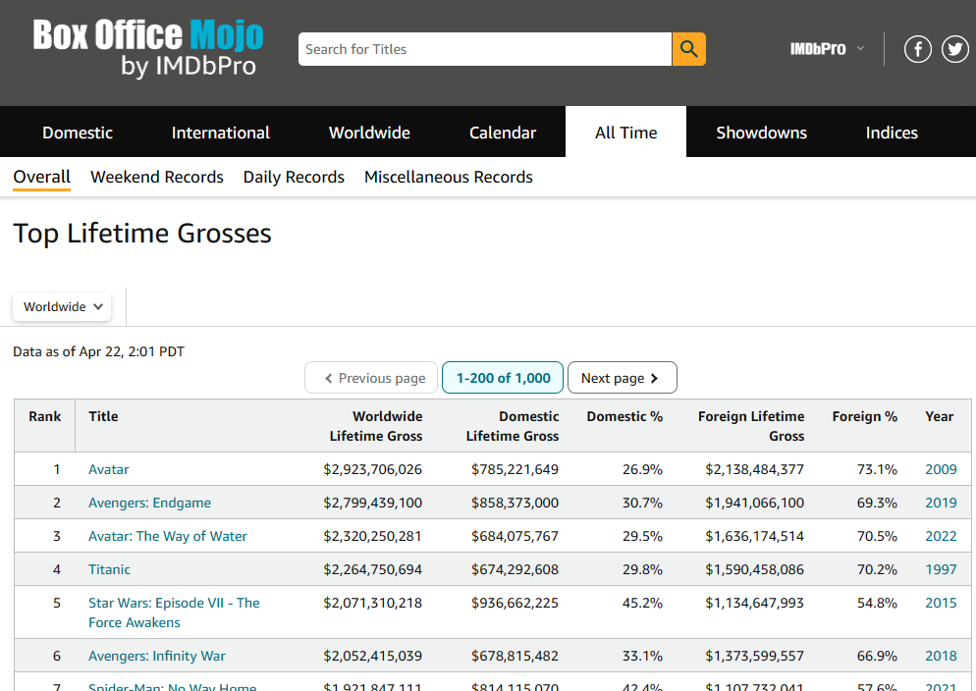
Let’s go to the movies!
Viewer Ratings vs Ticket Sales
https://www.imdb.com/chart/top/ https://www.boxofficemojo.com/chart/ww_top_lifetime_gross

Slide 8
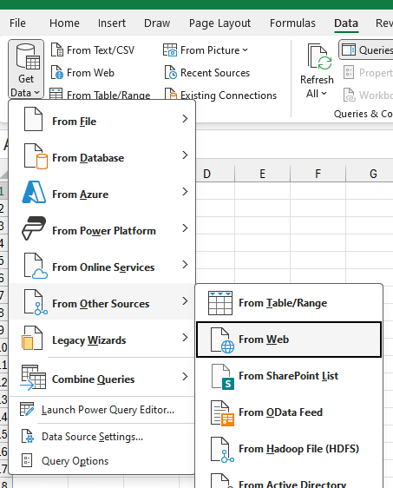
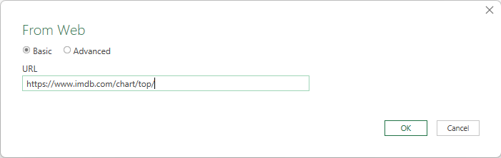
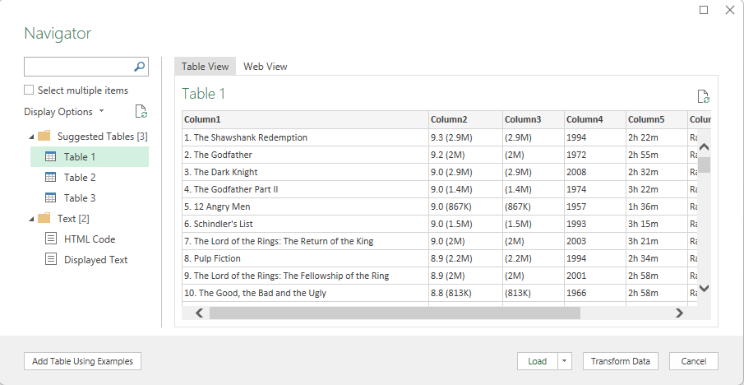
From Web – data preview

Slide 9
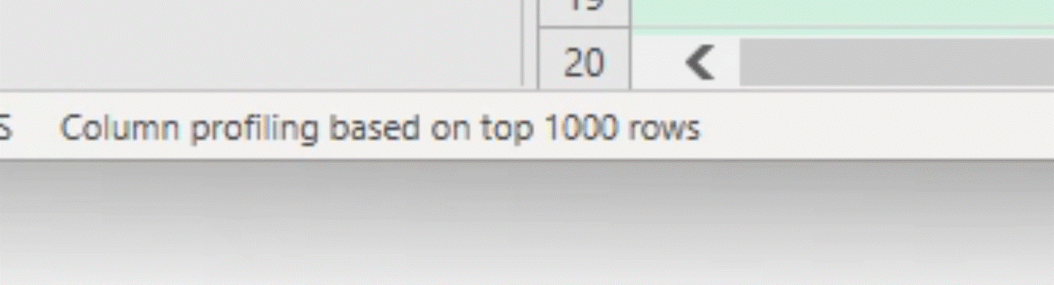
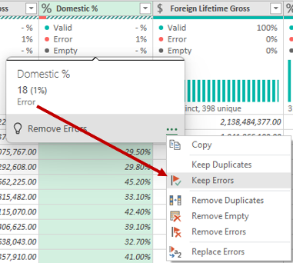
Column Quality - Find and fix errors
Note: the profile only looks at the top 1000 rows. Click status bar to use all rows.
Look for 0% errors
If there are errors, choose Keep Errors for that column.
Click on an error to drill into detail.
Inspect the results and then go back to previous step to make corrections.
More about Dealing with errors - Power Query

Slide 10
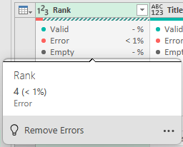
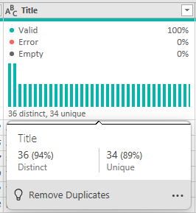
Column Profile - sniff test for your data
Look at Distinct vs. Unique values and think whether it makes sense to you.
Distinct: number of different values
Unique: number of values that occur only once
If there are more Distinct values, it means that some appear more than once

Slide 11
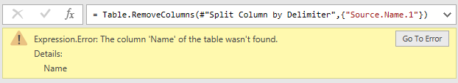
Common error – column wasn’t found
Happens if a step refers to a column name that doesn’t exist
Commonly caused by inserting steps – ex. renaming a column, removing a column
Click Go To Error or review previous steps to find where it starts
Fix or remove name in later steps

Slide 12
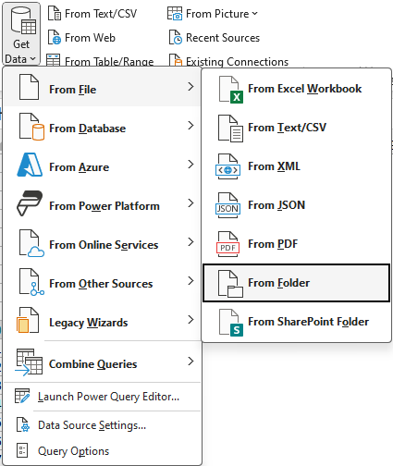
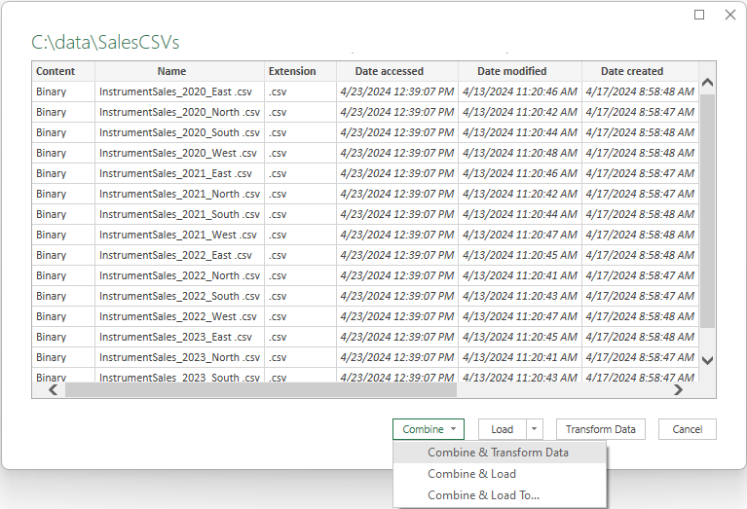
Combine many files together!
Get Data > From Folder
Choose Combine
PQ lets you clean up one example file from the set, and apply to all the files.
Then it combines data from all the files into a single data set.

Slide 13
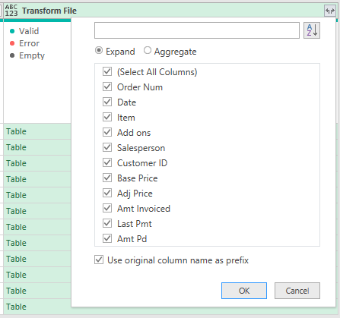
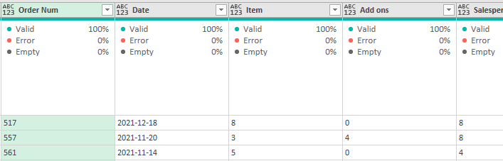
Where’s the data hiding?
When you have values that say “Table”, expand it to reveal all the data.

Slide 14
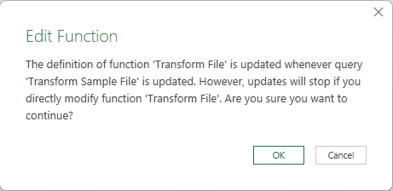
Tips for getting data From Folder
Filter the list to ensure only intended files to avoid unexpected results.
Pick a relevant sample file.
Don’t edit the “Transform File” function, edit “Transform Sample File” instead.
You can use PQ to get information about the files, rather than data from inside the files, if needed.
Ex. How many files match my criteria?

Slide 15
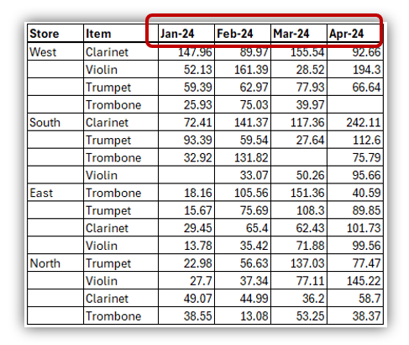
“Unsummarizing” with Unpivot
Data may be pre-aggregated or arranged so that it’s not flexible in a PivotTable
Look for:
Column headings that are values, such as month names, region names, group names.
Multiple row headers
Outline format (empty cells)
Unpivot lets you transform it to tabular format

Slide 16
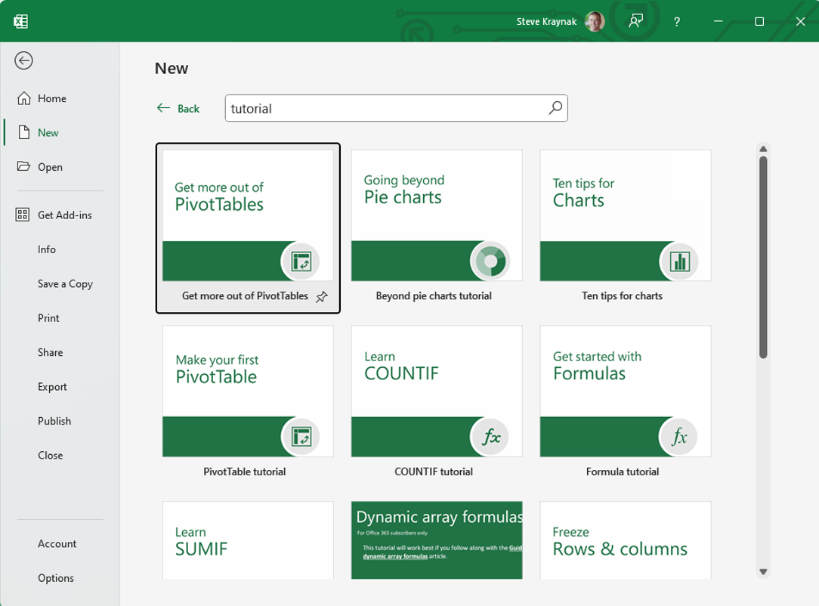
Learning right in Excel!
Go to File > New
Search for “tutorial”

Slide 17







SumProduct
We are experts in Excel, Power BI, Power Automate, Financial & Strategic Data Modelling, Model Auditing, Planning & Strategy and Training.
Training
Modeling
Planning
Strategy

Slide 18
Contact us
For more information, please do not hesitate to contact us.
George Mount
Founder
1 440 879 8399
george@stringfestanalytics.com
www.stringfestanalytics.com

